Slide 1

Working with Assistants Part 18: Wrapping Up

Slide 2
What Did We Coverer in This Series
Creating and Managing Assistants
Creating and Managing Threads
Creating and Managing Messages
Creating and Managing Runs
Working with Run Steps
Working with File Search
Creating and Managing Vector Stores
Working with File Search Annotations
Working with Code Interpreter
Working with Functions

Slide 3
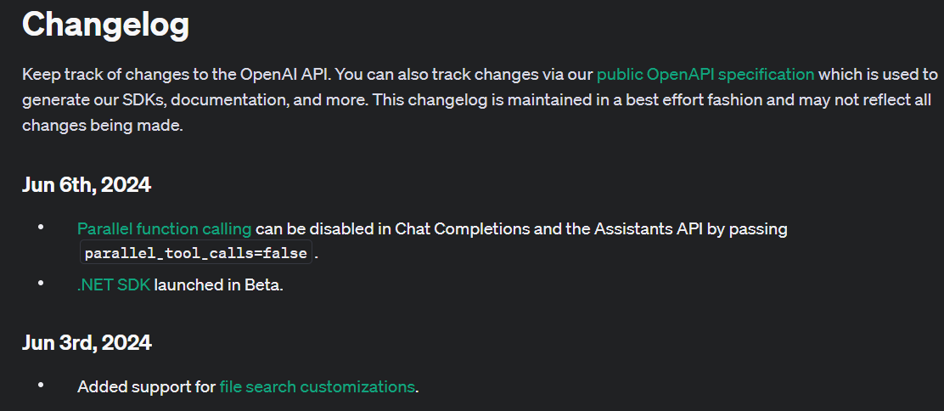
Watch for the Changes!
Notes:
https://platform.openai.com/docs/changelog

Slide 4
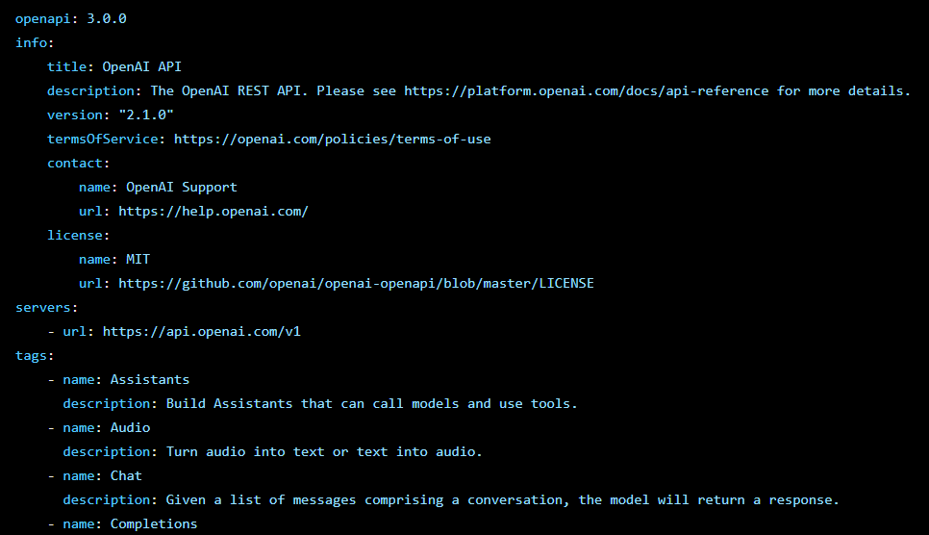
If Like Pain, Then Read the Spec!
Notes:
https://github.com/openai/openai-openapi/blob/master/openapi.yaml

Slide 5



Notes:
https://www.youtube.com/channel/UC35ZpwldGw7ZJ5R-2sLijzw

Slide 6
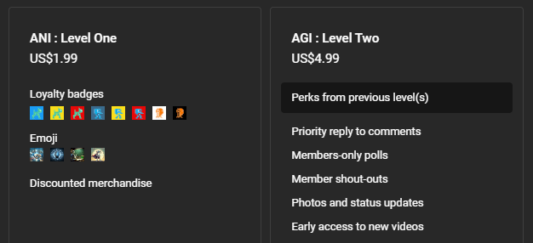

Membership has its privileges
Notes:
https://www.youtube.com/channel/UC35ZpwldGw7ZJ5R-2sLijzw/join

Slide 7

https://www.youtube.com/@AINewsFresh

Slide 8
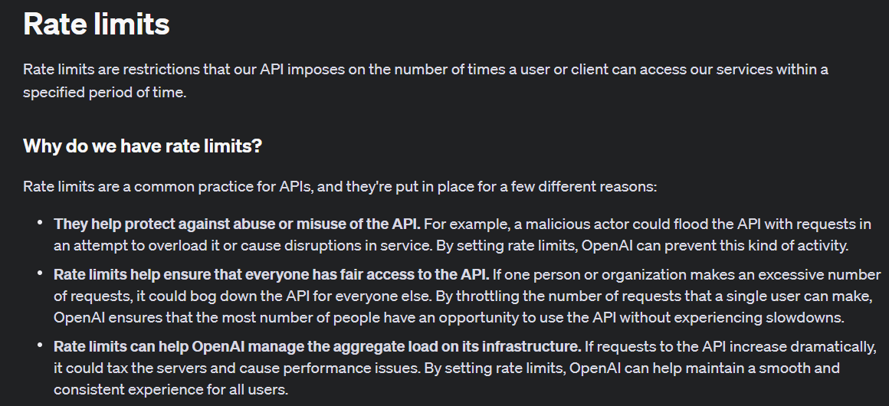
Know Your Limits!
Notes:
https://platform.openai.com/docs/guides/rate-limits/rate-limits

Slide 9
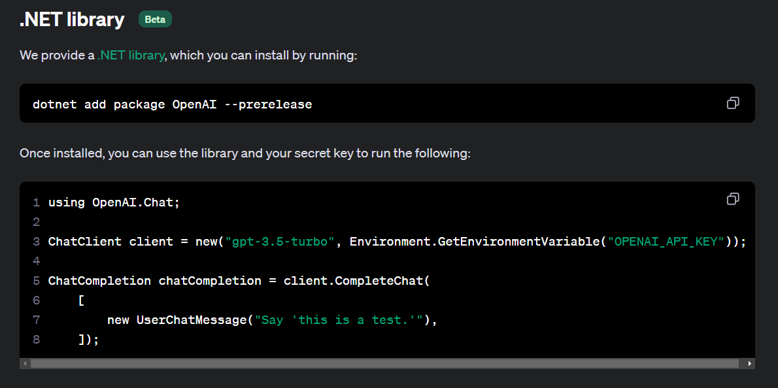
Using Other Languages
Notes:
https://platform.openai.com/docs/libraries/libraries

Slide 10
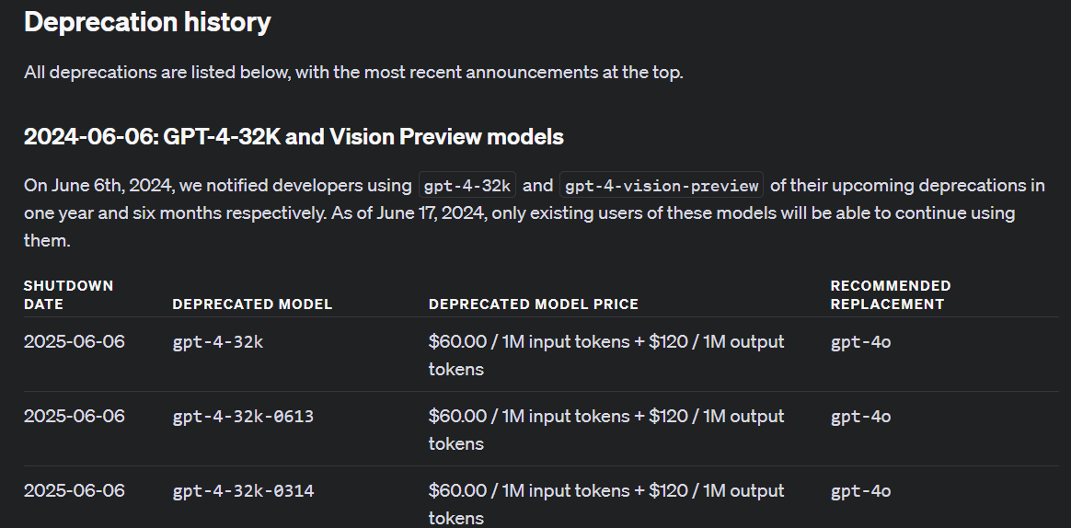
Watch Out for Models Going Away!
Notes:
https://platform.openai.com/docs/deprecations/deprecations

Slide 11


